Slide 1
Sorting

Slide 2
Sorting
Sorting refers to ordering data in an increasing or decreasing fashion according to some linear relationship among the data items.
The most common uses of sorted sequences are:
  making lookup or search efficient;
  making merging of sequences efficient.
  enable processing of data in a defined order.

Slide 3
Why we do sorting?
Commonly encountered programming task in computing.
Examples of sorting:
  List containing exam scores sorted from Lowest to Highest or from Highest to Lowest
  List containing words that were misspelled and be listed in alphabetical order.
  List of student records and sorted by student number or alphabetically by first or last name.

Slide 4
Why we do sorting?
Searching for an element in an array will be more efficient. (example: looking up for information like phone number).
It’s always nice to see data in a sorted display. (example: spreadsheet or database application).
Computers sort things much faster.

Slide 5
History of Sorting
Sorting is one of the most important operations performed by computers. In the days of magnetic tape storage before modern databases, database updating was done by sorting transactions and merging them with a master file.
It's still important for presentation of data extracted from databases: most people prefer to get reports sorted into some relevant order before flipping through pages of data!

Slide 6
Sorting – Definitions
Input: n records, R₁ … R_{n} , from a file.
Each record R_{i} has
  a key K_{i}
  possibly other (satellite) information
The keys must have an ordering relation the following properties:
that satisfies
Trichotomy: For any two keys a and b, exactly one of a < b, a = b, or a ≤ b
is true.
■
Transitivity: For any three keys a, b, and c, if a < b and b < c, then a < c.
The relation ≤ is a total ordering (linear ordering) on keys.

Slide 7
Types
Bubble/Shell sort : Exchange two adjacent elements if they are out of order. Repeat until array is sorted.
Insertion sort : Scan successive elements for an out-of-order item, then insert the item in the proper place.
Selection sort : Find the smallest element in the array, and put it in the proper place. Swap it with the value in the first position. Repeat until array is sorted.
Quick sort : Partition the array into two segments. In the first segment, all elements are less than or equal to the pivot value. In the second segment, all elements are greater than or equal to the pivot value. Finally, sort the two segments recursively.
Merge sort : Divide the list of elements in two parts, sort the two parts individually and then merge it.

Slide 8
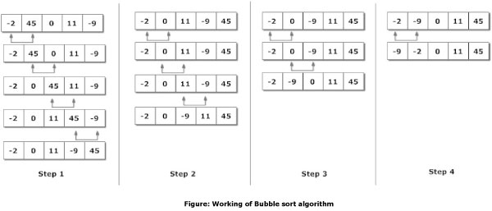
Bubble Sort
Exchange two adjacent elements if they are out of order. Repeat until array is sorted.

Slide 9
Bubble Sort Example
9, 6, 2, 12, 11, 9, 3, 7
bubblesortexample.ppt
6, 9, 2, 12, 11, 9, 3, 7
6, 2, 9, 12, 11, 9, 3, 7
6, 2, 9, 12, 11, 9, 3, 7
6, 2, 9, 11, 12, 9, 3, 7
6, 2, 9, 11, 9, 12, 3, 7
6, 2, 9, 11, 9, 3, 12, 7
6, 2, 9, 11, 9, 3, 7, 12

Slide 10

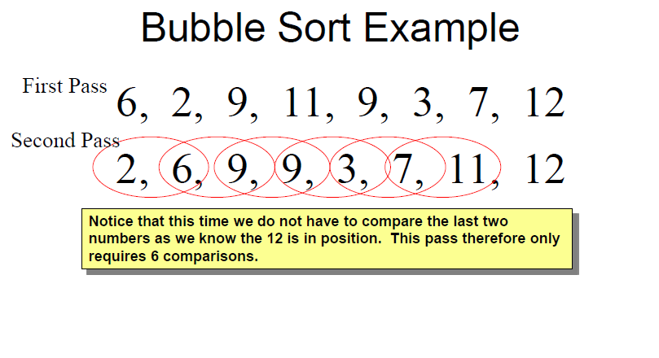

Slide 11
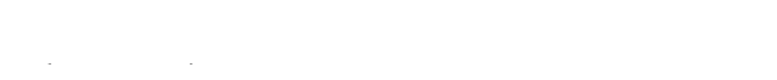
^{First Pass} 6, 2, 9, 11, 9, 3, 7, 12
Bubble Sort Example
Second Pass
2, 6, 9, 9, 3, 7, 11, 12
Third Pass
2, 6, 9, 3, 7, 9, 11, 12
2, 6, 9, 9, 3, 7, 11, 12
2, 6, 9, 3, 9, 7, 11, 12
This time the 11 and 12 are in position. This pass therefore only requires 5 comparisons.

Slide 12
Bubble Sort Example
^{First Pass} 6, 2, 9, 11, 9, 3, 7, 12
Second Pass
Third Pass Fourth Pass
2, | 6, | 9, | 9, | 3, | 7, | 11, | 12
2, 6, 9, 3, 7, 9, 11, 12
2, | 6, | 3, | 7, | 9, | 9, | 11, | 12
2, 6, 9, 3, 7, 9, 11, 12
2, 6, 3, 9, 7, 9, 11, 12
Each pass requires fewer comparisons. This time only 4 are needed.

Slide 13
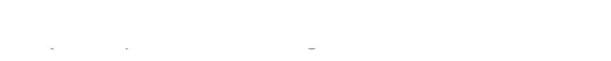
Bubble Sort Example
^{First Pass} 6, 2, 9, 11, 9, 3, 7, 12
Second Pass
Third Pass Fourth Pass
Fifth Pass
2, | 6, | 9, | 9, | 3, | 7, | 11, | 12
2, 6, 9, 3, 7, 9, 11, 12
2, | 6, | 3, | 7, | 9, | 9, | 11, | 12
2, | 3, | 6, | 7, | 9, | 9, | 11, | 12
2, 6, 3, 7, 9, 9, 11, 12
The list is now sorted but the algorithm does not know this until it completes a pass with no exchanges.

Slide 14
Bubble Sort Example
^{First Pass} 6, 2, 9, 11, 9, 3, 7, 12
Second Pass
Third Pass
Fourth Pass
Fifth Pass
Sixth Pass
2, 6, 9, 9, 3, 7, 11, 12
2, 6, 9, 3, 7, 9, 11, 12
2, 6, 3, 7, 9, 9, 11, 12
2, 3, 6, 7, 9, 9, 11, 12
2, 3, 6, 7, 9, 9, 11, 12

Slide 15


Bubble Sort Quiz
Which number is definitely in its correct position at the end of the
first pass?
  Answer: The last number must be the largest.
How does the number of comparisons required change as the pass number increases?
  Answer: Each pass requires one fewer comparison than the last.
How does the algorithm know when the list is sorted?
  Answer: When a pass with no exchanges occurs.
What is the maximum number of comparisons required for a list of 10 numbers?
  Answer: 9 comparisons, then 8, 7, 6, 5, 4, 3, 2, 1 so total 45

Slide 16
Algorithm – Bubble Sort
begin BubbleSort(list)
for all elements of list
if list[i] > list[i+1]
swap(list[i], list[i+1])
end if
end for
return list
end BubbleSort

Slide 17
#include <stdio.h>
int main()
{
int data[100], i, n, step, temp;
printf("Enter the number of elements to be sorted: ");
scanf("%d",&n);
for(i=0;i<n;++i)
{
printf("%d. Enter element: ",i+1);
scanf("%d",&data[i]);
}
for(step=0;step<n-1;++step)
for(i=0;i<n-step-1;++i)
{
if(data[i]>data[i+1]) /* To sort in descending order, change > to < in this line. */
{
temp=data[i]; data[i]=data[i+1]; data[i+1]=temp;
}
}
printf("In ascending order: ");
for(i=0;i<n;++i)
printf("%d ", data[i]);
return 0;
}

Slide 18

2. Insertion Sort

Slide 19
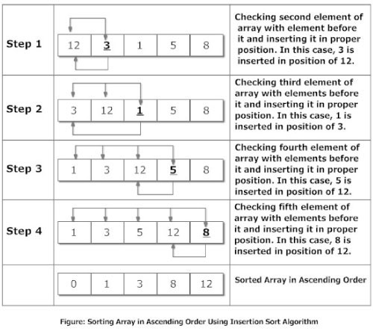
Insertion Sort
Scan successive elements for an out-of-order item, then insert the item in the proper place.

Slide 20
Example of insertion sort
8 2 4 9 3 6

Slide 21
Example of insertion sort
8 2 4 9 3 6

Slide 22
Example of insertion sort
8 2 4 9 3 6
2 8 4 9 3 6

Slide 23
Example of insertion sort
8 2 4 9 3 6
2 8 4 9 3 6

Slide 24
Example of insertion sort
8 | 2 | 4 | 9 | 3 | 6
2 | 8 | 4 | 9 | 3 | 6
2 | 4 | 8 | 9 | 3 | 6
L1.<number>

Slide 25
Example of insertion sort
8 | 2 | 4 | 9 | 3 | 6
2 | 8 | 4 | 9 | 3 | 6
2 | 4 | 8 | 9 | 3 | 6
L1.<number>

Slide 26
Example of insertion sort
8 | 2 | 4 | 9 | 3 | 6
2 | 8 | 4 | 9 | 3 | 6
2 | 4 | 8 | 9 | 3 | 6
2 | 4 | 8 | 9 | 3 | 6

Slide 27
Example of insertion sort
8 | 2 | 4 | 9 | 3 | 6
2 | 8 | 4 | 9 | 3 | 6
2 | 4 | 8 | 9 | 3 | 6
2 | 4 | 8 | 9 | 3 | 6

Slide 28
Example of insertion sort
8 | 2 | 4 | 9 | 3 | 6
2 | 8 | 4 | 9 | 3 | 6
2 | 4 | 8 | 9 | 3 | 6
2 | 4 | 8 | 9 | 3 | 6
2 | 3 | 4 | 8 | 9 | 6

Slide 29
Example of insertion sort
8 | 2 | 4 | 9 | 3 | 6
2 | 8 | 4 | 9 | 3 | 6
2 | 4 | 8 | 9 | 3 | 6
2 | 4 | 8 | 9 | 3 | 6
2 | 3 | 4 | 8 | 9 | 6

Slide 30
Example of insertion sort
8 | 2 | 4 | 9 | 3 | 6
2 | 8 | 4 | 9 | 3 | 6
2 | 4 | 8 | 9 | 3 | 6
2 | 4 | 8 | 9 | 3 | 6
2 | 3 | 4 | 8 | 9 | 6
2 | 3 | 4 | 6 | 8 | 9 | done

Slide 31
Algorithm – Insertion Sort
Step 1 − If it is the first element, it is already sorted. return 1;
Step 2 − Pick next element
Step 3 − Compare with all elements in the sorted sub-list
Step 4 − Shift all the elements in the sorted sub-list that is greater than the value to be sorted
Step 5 − Insert the value
Step 6 − Repeat until list is sorted

Slide 32
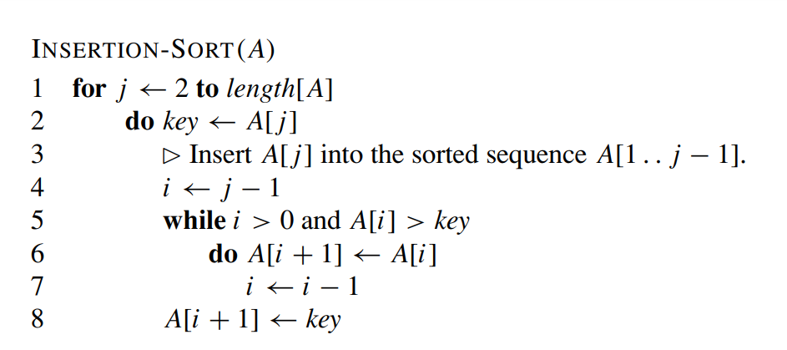
Algorithm – Insertion Sort

Slide 33
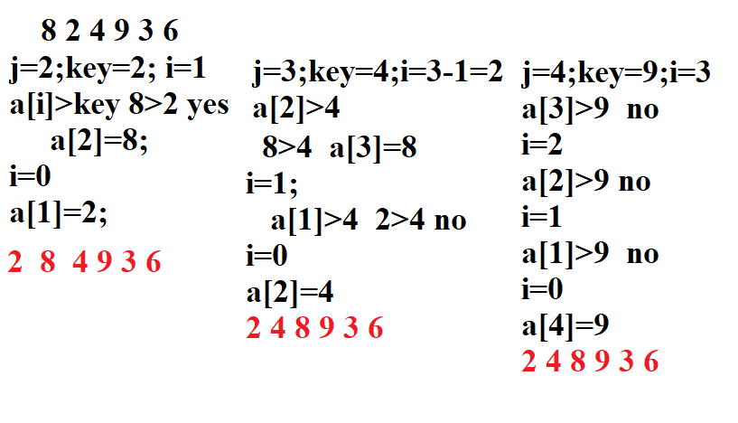
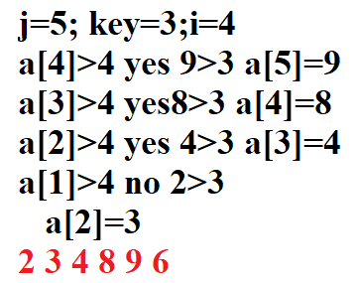


Slide 34
#include<stdio.h>
int main()
{ int data[100],n,temp,i,j;
printf("Enter number of terms(should be less than 100): ");
scanf("%d",&n);
printf("Enter elements: ");
for(i=0;i<n;i++)
{ scanf("%d",&data[i]);
}
for(i=1;i<n;i++)
{
temp = data[i];
j=i-1;
while(temp<data[j] && j>=0)
/*To sort elements in descending order, change temp<data[j] to temp>data[j] in above line.*/
{
data[j+1] = data[j];
--j;
}
data[j+1]=temp;
}
printf("In ascending order: ");
for(i=0; i<n; i++)
printf("%d\t",data[i]);
return 0;
}

Slide 35
3. Selection sort

Slide 36

Selection sort
How does it work:
  first find the smallest in the array and exchange it with the element in the first position, then find the second smallest element and exchange it with the element in the second position, and continue in this way until the entire array is sorted.
How does it sort the list in a non increasing order?
Selection sort is:
  The simplest sorting techniques.
  a good algorithm to sort a small number of elements
  an incremental algorithm – induction method

Slide 37

Selection sort
Selection sort is Inefficient for large lists.
Incremental algorithms
process the input elements one-by-one and maintain the solution for the elements processed so far.

Slide 38
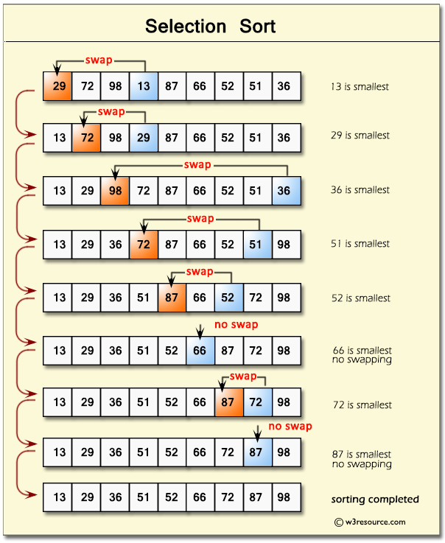

Slide 39

Selection Sort Algorithm
Input: An array A[1..n] of n elements.
Output: A[1..n] sorted in nondecreasing order.
1. for i ← 1 to n - 1
k ← i
for j ← i + 1 to n
if A[j] < A[k] then k ← j
end for
if k ≠ i then interchange A[i] and A[k]
{Find the i th smallest element.}
7. end for

Slide 40

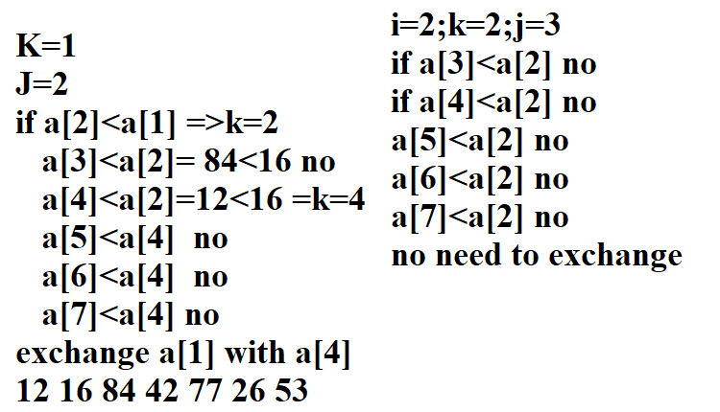

Slide 41
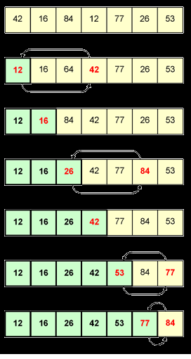

Slide 42
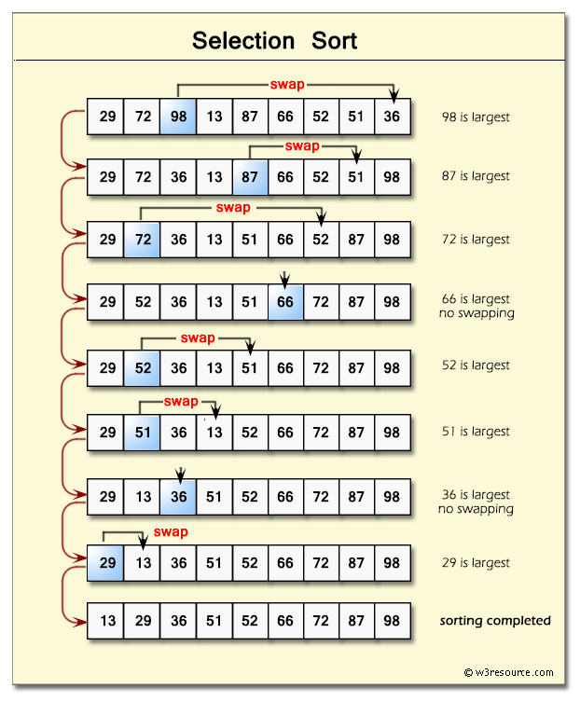

Slide 43

Analysis of Selection Sort Algorithms
Algorithm analysis: quantify the performance of the algorithm,
i.e., the amount of time and space taken in terms of n.
T(n) is the total number of accesses made from the beginning of selection_sort until the end.
selection_sort itself simply calls swap and find_min_index as i
goes from 1 to n-1
T (n) = ∑ find − min − element + swap
i =1
= n-1 + n-2 + n-3 + … + 1 = n(n-1)/2
Or = ∑ (n - i) = n (n - 1) / 2 -→ O(n²)
n−1

Slide 44
4. Quick sort

Slide 45
Quick Sort -Introduction
Is a divide-and-conquer recursive algorithm, like mergesort
Quicksort pros [advantage]:
  Sorts in place
  Sorts O(n lg n) in the average case
  Very efficient in practice , it’s quick
Quicksort cons [disadvantage]:
  Sorts O(n²) in the worst case
  And the worst case doesn’t happen often … sorted

Slide 46

QuickSort
v
Divide step:
  Pick any element (pivot) v in S
S
Partition S – {v} into two disjoint groups
S1 = {x ∈ S – {v} | x <= v}
S2 = {x ∈ S – {v} | x ≥ v}
Conquer step: recursively sort S1 and S2
v
S1
S2
Combine step: the sorted S1 (by the time returned from recursion), followed by v, followed by the sorted S2 (i.e., nothing extra needs to be done)

Slide 47
Quick Sort
Quick Sort is a Divide and Conquer algorithm. It picks an element as pivot and partitions the given array around the picked pivot. There are many different versions of Quick Sort that pick pivot in different ways.
    Always pick first element as pivot.
    Always pick last element as pivot (implemented below)
    Pick a random element as pivot.
    Pick median as pivot.

Slide 48
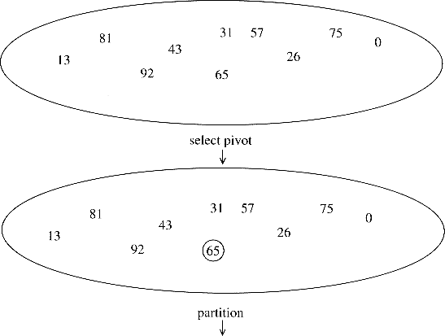
Quicksort Example 1 (1/2)

Slide 49
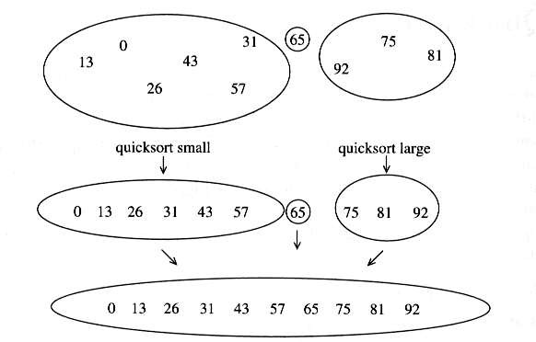
Quicksort Example 1 (2/2)

Slide 50
QUICK SORT
/* low --> Starting index, high --> Ending index
*/quickSort(arr[], low, high)
{
if (low < high)
{
/* pi is partitioning index, arr[pi] is now at right place */
pi = partition(arr, low, high);
quickSort(arr, low, pi - 1); // Before pi
quickSort(arr, pi + 1, high); // After pi
}
}

Slide 51
/* This function takes last element as pivot, places the pivot element at its correct position in sorted array, and places all smaller (smaller than pivot) to left of pivot and all greater elements to right of pivot */
partition (arr[], low, high)
{ // pivot (Element to be placed at right position)
pivot = arr[high];
i = (low - 1) // Index of smaller element
for (j = low; j <= high- 1; j++)
{
// If current element is smaller than the pivot
if (arr[j] < pivot)
{ i++; // increment index of smaller element
swap arr[i] and arr[j]
}
}
swap arr[i + 1] and arr[high])
return (i + 1)
}

Slide 52


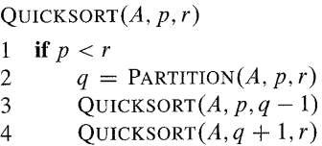
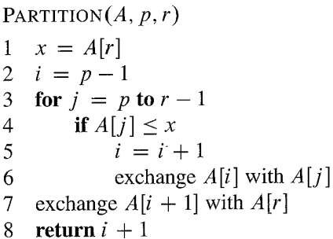
QuickSort
The Pseudo-Code

Slide 53
Illustration of partition() :
arr[] = {10, 80, 30, 90, 40, 50, 70}
Indexes: 0 1 2 3 4 5 6
low = 0, high = 6, pivot = arr[h] = 70
Initialize index of smaller element, i = -1
Traverse elements from j = low to high-1
j = 0 : Since arr[j] <= pivot, do i++ and swap(arr[i], arr[j])
i = 0
arr[] = {10, 80, 30, 90, 40, 50, 70}
// No change as i and j are same
j = 1 : Since arr[j] > pivot, do nothing
// No change in i and arr[]
j = 2 : Since arr[j] <= pivot, do i++ and swap(arr[i], arr[j])
i = 1
arr[] = {10, 30, 80, 90, 40, 50, 70} // We swap 80 and 30
j = 3 : Since arr[j] > pivot, do nothing
// No change in i and arr[]
j = 4 : Since arr[j] <= pivot, do i++ and swap(arr[i], arr[j])
i = 2
arr[] = {10, 30, 40, 90, 80, 50, 70} // 80 and 40 Swapped
j = 5 : Since arr[j] <= pivot, do i++ and swap arr[i] with arr[j]
i = 3
arr[] = {10, 30, 40, 50, 80, 90, 70} // 90 and 50 Swapped
We come out of loop because j is now equal to high-1.
Finally we place pivot at correct position by swapping arr[i+1] and arr[high] (or pivot)
arr[] = {10, 30, 40, 50, 70, 90, 80} // 80 and 70 Swapped
Now 70 is at its correct place. All elements smaller than 70 are before it and all elements greater than 70 are after it.

Slide 54
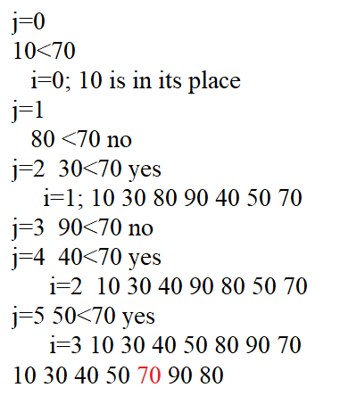

Slide 55

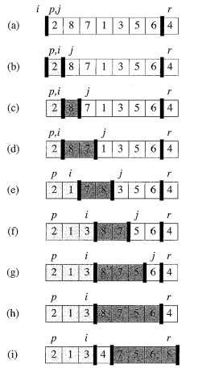
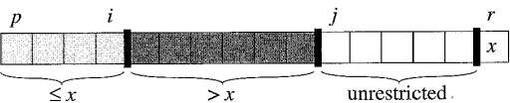
QuickSort

Slide 56
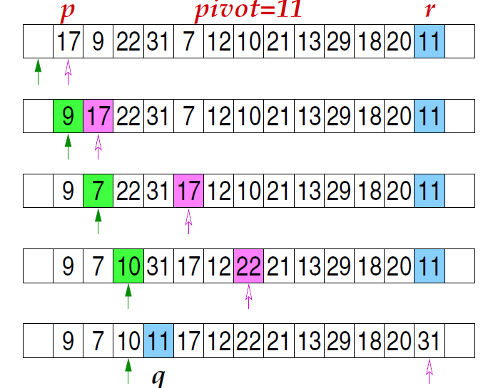

Slide 57
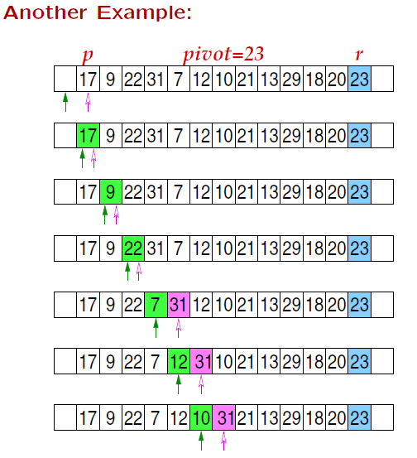

Slide 58

QuickSort
Like in MERGESORT, we use Divide-and-Conquer:
Divide: partition A[p..r] into two subarrays A[p..q-1] and A[q+1..r] such that each element of A[p..q-1] is ≤ A[q], and each element of A[q+1..r] is ≥ A[q]. Compute q as part of this partitioning.
Conquer: sort the subarrays A[p..q-1] and A[q+1..r] by recursive calls to QUICKSORT.
Combine: the partitioning and recursive sorting leave us with a sorted A[p..r] – no work needed here.
An obvious difference is that we do most of the work in the divide stage, with no work at the combine one.

Slide 59

Analysis of QuickSort (1/2)
Levels in call tree (log n)
Elements at each level (average case)
  Level 0 (1 vector of n elements)
  Level 1 (2 vectors of approx. n/2 elements)
  Level 2 (4 vectors of approx. n/4 elements)
  ….
  Level k (2^{k} vectors of approx. n/2^{k} elements)
  Each level has n elements & O(n) effort required to find all pivotIndexes & partitions at each level
  There are approx. k = log n level
QuickSort is O(n log n) in best and average cases

Slide 60
Analysis of QuickSort
T(n) = T(k) + T(n-k-1) + (n)The first two terms are for two recursive calls, the last term is for the partition process. k is the number of elements which are smaller than pivot.
Worst Case: The worst case occurs when the partition process always picks greatest or smallest element as pivot. If we consider above partition strategy where last element is always picked as pivot, the worst case would occur when the array is already sorted in increasing or decreasing order. Following is recurrence for worst case.
T(n) = T(0) + T(n-1) + (n) which is equivalent to T(n) = T(n-1) + (n)The solution of above recurrence is (n²).

Slide 61
Best Case: when the partition process always picks the middle element as pivot. Following is recurrence for best case.
T(n) = 2T(n/2) + (n)The solution of above recurrence is (nLogn).
Average Case:
To do average case analysis, we need to consider all possible permutation of array and calculate the time taken by every permutation which doesn’t look easy.
We can get an idea of average case by considering the case when partition puts O(n/9) elements in one set and O(9n/10) elements in other set. Following is recurrence for this case.
T(n) = T(n/9) + T(9n/10) + (n) Solution of above recurrence is also O(nLogn)

Slide 62
5. Merge sort

Slide 63
Merge Sort
Merge sort is one of the most efficient sorting algorithms.
It works on the principle of Divide and Conquer.
Merge sort is a divide and conquer algorithm that was invented by John Von Neumann in 1945
Merge sort repeatedly breaks down a list into several sublists until each sublist consists of a single element and merging those sublists in a manner that results into a sorted list.
With worst-case time complexity being Ο(n log n), it is one of the most respected algorithms.

Slide 64
Like Quick Sort, Merge Sort is a Divide and Conquer algorithm.
It divides the input array into two halves, calls itself for the two halves, and then merges the two sorted halves.
The merge() function is used for merging two halves.
The merge(arr, l, m, r) is a key process that assumes that arr[l..m] and arr[m+1..r] are sorted and merges the two sorted sub-arrays into one.

Slide 65
Algorithm – Merge Sort
Step 1 − if it is only one element in the list it is already sorted, return.
Step 2 − divide the list recursively into two halves until it can no more be divided.
Step 3 − merge the smaller lists into new list in sorted order.

Slide 66
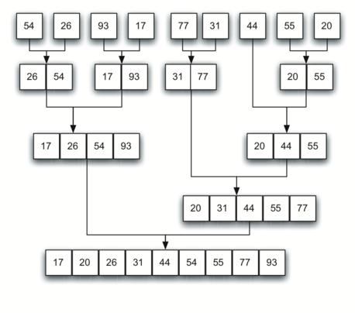
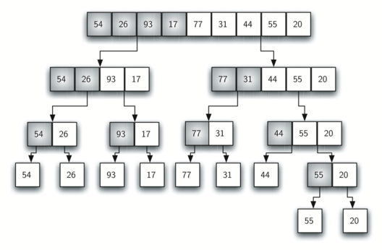
Merge Sort

Slide 67
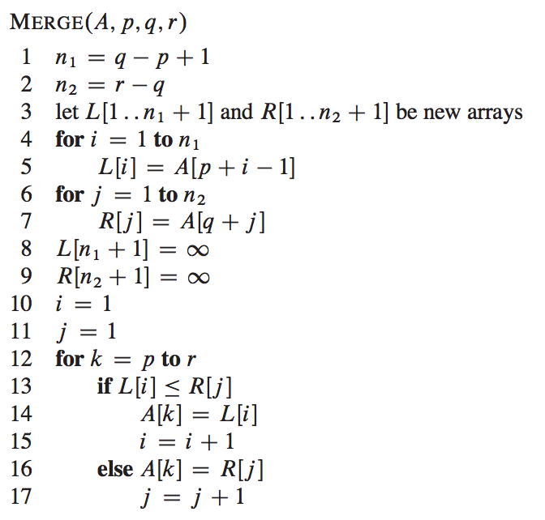
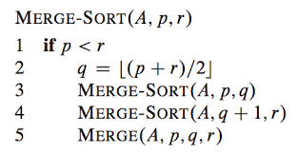
Psedo code for Merge Sort Algorithm

Slide 68
/* C program for Merge Sort */
#include <stdio.h>
#include <stdlib.h>
// Merges two subarrays of arr[].
// First subarray is arr[l..m]
// Second subarray is arr[m+1..r]
void merge(int arr[], int l, int m, int r)
{
int i, j, k;
int n1 = m - l + 1;
int n2 = r - m;
/* create temp arrays */
int L[n1], R[n2];
/* Copy data to temp arrays L[] and R[] */
for (i = 0; i < n1; i++)
L[i] = arr[l + i];
for (j = 0; j < n2; j++)
R[j] = arr[m + 1 + j];
/* Merge the temp arrays back into arr[l..r]*/
i = 0; // Initial index of first subarray
j = 0; // Initial index of second subarray
k = l; // Initial index of merged subarray
while (i < n1 && j < n2) {
if (L[i] <= R[j]) {
arr[k] = L[i];
i++;
}
else {
arr[k] = R[j];
j++;
}
k++;
}
/* Copy the remaining elements of L[], if there are any */
while (i < n1) {
arr[k] = L[i];
i++;
k++;
}

Slide 69
/* Copy the remaining elements of R[], if there are any */
while (j < n2) {
arr[k] = R[j];
j++;
k++;
}
}
/* l is for left index and r is right index of the
sub-array of arr to be sorted */
void mergeSort(int arr[], int l, int r)
{ if (l < r) {
// Same as (l+r)/2, but avoids overflow for
// large l and h
int m = l + (r - l) / 2;
// Sort first and second halves
mergeSort(arr, l, m);
mergeSort(arr, m + 1, r);
merge(arr, l, m, r);
}
}
/* Function to print an array */
void printArray(int A[], int size)
{ int i;
for (i = 0; i < size; i++)
printf("%d ", A[i]);
printf("\n");
}
int main()
{
int arr[] = { 12, 11, 13, 5, 6, 7 };
int arr_size = sizeof(arr) / sizeof(arr[0]);
printf("Given array is \n");
printArray(arr, arr_size);
mergeSort(arr, 0, arr_size - 1);
printf("\nSorted array is \n");
printArray(arr, arr_size);
return 0;
}

Slide 70
void sort(int low, int high)
{
int mid;
if(low < high) {
mid = (low + high) / 2;
sort(low, mid);
sort(mid+1, high);
merging(low, mid, high);
} else {
return;
}
}
void merging(int low, int mid, int high)
{
int l1, l2, i;
for(l1 = low, l2 = mid + 1, i = low; l1 <= mid && l2 <= high; i++)
{
if(a[l1] <= a[l2])
b[i] = a[l1++];
else
b[i] = a[l2++];
}
while(l1 <= mid) // if anything leftout
b[i++] = a[l1++];
while(l2 <= high) // if anything leftout
b[i++] = a[l2++];
for(i = low; i <= high; i++)
a[i] = b[i];
}

Slide 71
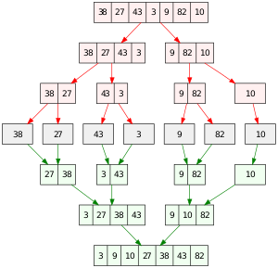

Slide 72
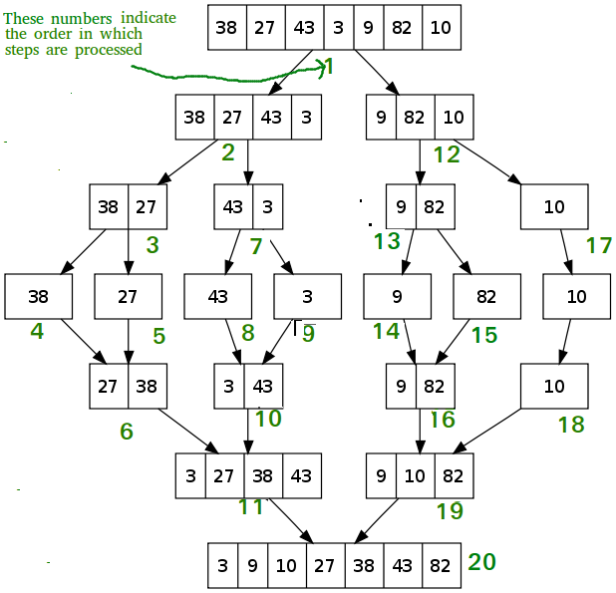

Slide 73
Psedo code for Merge Sort Algorithm

Slide 74
Time Complexity: Sorting arrays on different machines. Merge Sort is a recursive algorithm and time complexity can be expressed as following recurrence relation.
T(n) = 2T(n/2) + θ(n)
Time complexity of Merge Sort is θ(nLogn) in all 3 cases (worst, average and best) as merge sort always divides the array into two halves and takes linear time to merge two halves.

Slide 75
Applications of Merge Sort
Merge Sort is useful for sorting linked lists in O(nlogn) times.
Inversion Count Problem
Used in External Sorting
Slower comparative to the other sort algorithms for smaller tasks.
Merge sort algorithm requires additional memory space of 0(n) for the temporary array .
It goes through the whole process even if the array is sorted.
Drawbacks of Merge Sort

Slide 76

6. Counting Sort
106

Slide 77
Sort according to key values without comparing values
Instead by Counting the elements having distinct values
Note : The key values should not be negative
Let A is the given array with 17 elements
The values lies between 0 ≤ a[i] ≤ k, where k be the max values in the range.
2 | 1 | 1 | 0 | 2 | 5 | 4 | 0 | 2 | 8 | 7 | 7 | 9 | 2 | 0 | 1 | 9

Slide 78
step1
Initialize all the array elements of count with zero with the max of k elements
step2
0 | 1 | 2 | 3 | 4 | 5 | 6 | 7 | 8 | 9
Count
0 | 0 | 0 | 0 | 0 | 0 | 0 | 0 | 0 | 0
2 | 1 | 1 | 0 | 2 | 5 | 4 | 0 | 2 | 8 | 7 | 7 | 9 | 2 | 0 | 1 | 9
for(i=0; i<n; i++)
{
++ count[a[i]] ;
}
0 | 1 | 2 | 3 | 4 | 5 | 6 | 7 | 8 | 9
Count
3 | 3 | 4 | 0 | 1 | 1 | 0 | 2 | 1 | 2
i) Read the value in the given array A
ii) Go to the respective index in the count array
iii) Increment its value by 1

Slide 79
Step 3
Update the count array by adding adjacent elements
0 | 1 | 2 | 3 | 4 | 5 | 6 | 7 | 8 | 9
3 | 6 | 10 | 10 | 11 | 12 | 12 | 14 | 15 | 17
for(i=1; i<k; i++)
{
count[i]=count[i]+count[i-1] ;
}

Slide 80
Step 4
To maintain the stability start the process from the last element of the given array A
Given array A
2 | 1 | 1 | 0 | 2 | 5 | 4 | 0 | 2 | 8 | 7 | 7 | 9 | 2 | 0 | 1 | 9
0 | 1 | 2 | 3 | 4 | 5 | 6 | 7 | 8 | 9
Count
3 | 6 | 10 | 10 | 11 | 12 | 12 | 14 | 15 | 17
B
0 | 0 | 0 | 1 | 1 | 1 | 2 | 2 | 2 | 2 | 4 | 5 | 7 | 7 | 8 | 9 | 9
Read the key value from the given array A and Go to the index of the count array
Decrement the content by 1
Go to the index in the new array B
Insert the key
Repeat the steps from 1 to 4 until i>=0
for(i=n-1; i>=0; i--)
{
b[--count[a[i]]] = a[i];
}

Slide 81
Step 5
Copy the content of array b in array a
for(i=0; i<=n-1; i++)
{
a[i] = b[i];
}

Slide 82
Counting Sort Algorithm
Countingsort(A,n,k)
{ int count[k+1], b[n];
for(i=0;i<n;i++)
++count[a[i]] ;
for(i=1;i<=k; i++)
count[i] = count[i]+count[i-1];
for(i=n-1; i>=0; i--)
b[--count[a[i]]] = a[i];
for(i=0; i<=n-1; i++)
a[i] = b[i];
}
Efficiency of the algorithm
n+k+n+n = 3n+k = O(n+k)
=> O(n)

Slide 83
Drawbacks
1) when array A of size 100 but the range is from 0 to 10000
most of the elements be empty or zero
Therefore k should have the upper limit as k=O(n)
2) This algorithm will not work for negative and floating point numbers
Hint : find the highest negative number ( say -7) add all the number in the given array with 7 to make the negatives as positive then follow all the steps of the algorithm. Again subtract all the elements in the resulting sorted array with the same number.
3) Values lie in different range cannot be applied this method.

Slide 84

Counting Sort Is Stable
A sorting algorithm is stable if
  Numbers with the same value appear in the output array in the same order as they do in the input array
  Ties between two numbers are broken by the rule that which ever number appears first in the input array appears first in the output array
Line 9 of counting sort: for j←length[A] down to 1 is essential for counting sort to be stable
  What if for j ← 1 to length[A]

Slide 85
Additional Material

Slide 86
Another version of quick sort

Slide 87
Quicksort Example 2 (1/7)
The quicksort algorithm uses a series of recursive calls to partition a list into smaller and smaller sublists about a value called the pivot.
Example: Let v be a vector containing 10 integer values:
v = {800, 150, 300, 650, 550, 500, 400, 350, 450,
900}
pivot
500
150 300
650
550 800 400 350
450
900
v[0]
v[1]
v[2]
v[3]
v[4]
v[5]
v[6]
v[7]
v[8]
v[9]
scanUp
scanDown

Slide 88
Quicksort Example 2 (3/7)
pivot
Before the exchange
500
150
300
650
550 800
v[4] v[5]
400
350
450
900
v[0]
v[1]
v[2]
v[3]
v[6]
v[7]
v[8]
v[9]
scanUp
scanDown
pivot
After the exchange and updates to scanUp and scanDown
500
150
300 450 550 800 400 350 650
900
v[0]
v[1]
v[2] v[4]
v[5]
v[6]
v[7] v[8]
scanDown
v[9]
v[3]
scanUp

Slide 89
Quicksort Example 2 (3/7)
pivot
Before the exchange
450 550 800
500
150
300
400
350
650
900
v[0]
v[1]
v[2]
v[3]
v[4] v[5]
v[6]
v[7] v[8]
scanDown
v[9]
scanUp
pivot
After the exchange and updates to scanUp and scanDown
300 450 350 800 400 550 650
500
150
900
v[0]
v[1]
v[2] v[4]
v[6]
v[9]
v[3]
v[5] v[7] v[8]
scanUp
scanDown

Slide 90
Quicksort Example 2 (4/7)
pivot
Before the exchange
500
150
300
450
350 800 400
550
650
900
v[0]
v[1]
v[2]
v[3]
v[4] v[5]
v[6]
v[7]
v[8]
v[9]
scanUp
scanDown
pivot
After the exchange and updates to scanUp and scanDown
500
150
300 450 350 400 800 550 650
900
v[0]
v[1]
v[2] v[4]
v[6]
v[9]
v[3]
v[5] v[7] v[8]
scanDown scanUp

Slide 91
Quicksort Example 2 (4/7)
Pivot in its final position
400
150
300
450
350 500 800
550
650
900
v[0]
v[1]
v[2]
v[3]
v[4] v[5]
v[6]
v[7]
v[8]
v[9]
400 150 300 450 350 500 800 550 650
900
v[0]
v[1]
v[2]
v[3]
v[4]
v[5]
v[6]
v[7] v[8]
v[6] - v[9]
v[9]
v[0] - v[4]

Slide 92
Quicksort Example 2 (5/7)
pivot
Initial Values
150 400 450 350
pivot
After Scans Stop
150 400 450 350
300
300
v[0]
v[1]
v[2]
v[3]
v[4]
v[0]
v[1]
v[2]
v[3]
v[4]
scanUp
scanDown
scanDown
scanUp
150
300
400
450
350
v[0]
v[1]
v[2]
v[3]
v[4]

Slide 93
Quicksort Example 2 (6/7)
pivot
pivot
Initial Values After Stops
650
550 800 900
650
550 800 900
v[6]
v[7] v[8]
v[9]
v[6]
v[7] v[8]
v[9]
scanUp
scanDown
scanDown
scanUp
550
650
800
900
v[6]
v[7]
v[8]
v[9]

Slide 94
Quicksort Example 2 (7/7)
150 | 300 | 400 | 450 | 350 | 500 | 550 | 650 | 800 | 900
v[0]
v[1]
v[2]
v[3]
v[4]
v[5]
v[6]
v[7]
v[8]
v[9]
Before Partitioning
After Partitioning
400 | 450 | 350
350 | 400 | 450
v[2]
v[3]
v[4]
v[2]
v[3]
v[4]
150
300
350
400 450 500 550 650 800
900
v[0]
v[1]
v[2]
v[3]
v[4]
v[5]
v[6]
v[7]
v[8]
v[9]

